Slide 1
The Anti bullying Ambassadors present. . .
PFS Anti bullying week 2021

Slide 2
The theme this year is
ONE KIND WORD
It is EVERYONE’S mission to use ONE KIND WORD every day to someone new to make them feel good about themselves.

Slide 3
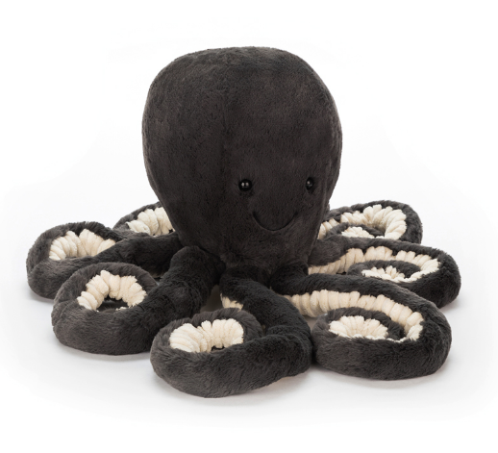
Today’s mission is sponsored by Open Minded Octopus :
Mindful
Monday
Try something new!
Belly Breathing: Mindfulness for Children - YouTube
Breathing helps us connect with our thoughts . . .
Do you have any worries?
How are you feeling?
Your mission today is to be mindful, look at the anti bullying resources and have a go at the letting off steam activity.

Slide 4

What will be your one kind word today?

Slide 5

Teamwork
Tuesday
Today’s mission is sponsored by :
Make it your mission to be an UPSTANDER!
What is an upstander?

Slide 6


Slide 7
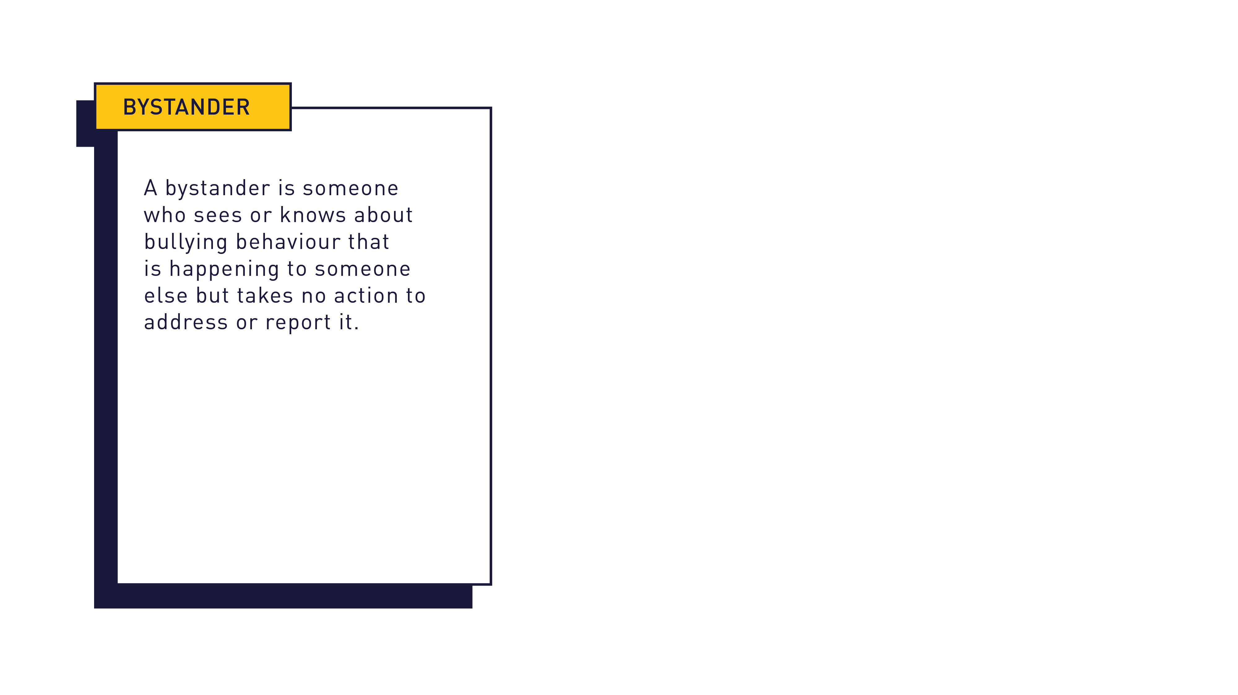

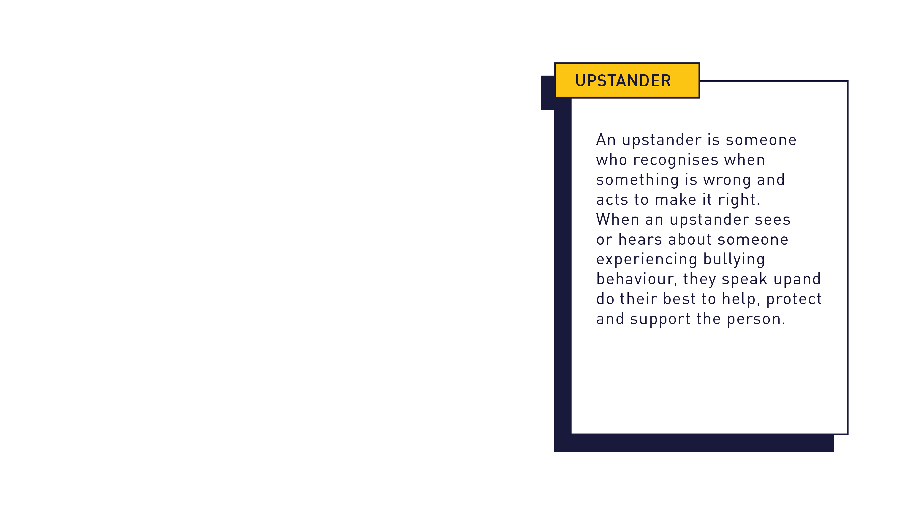

Slide 8
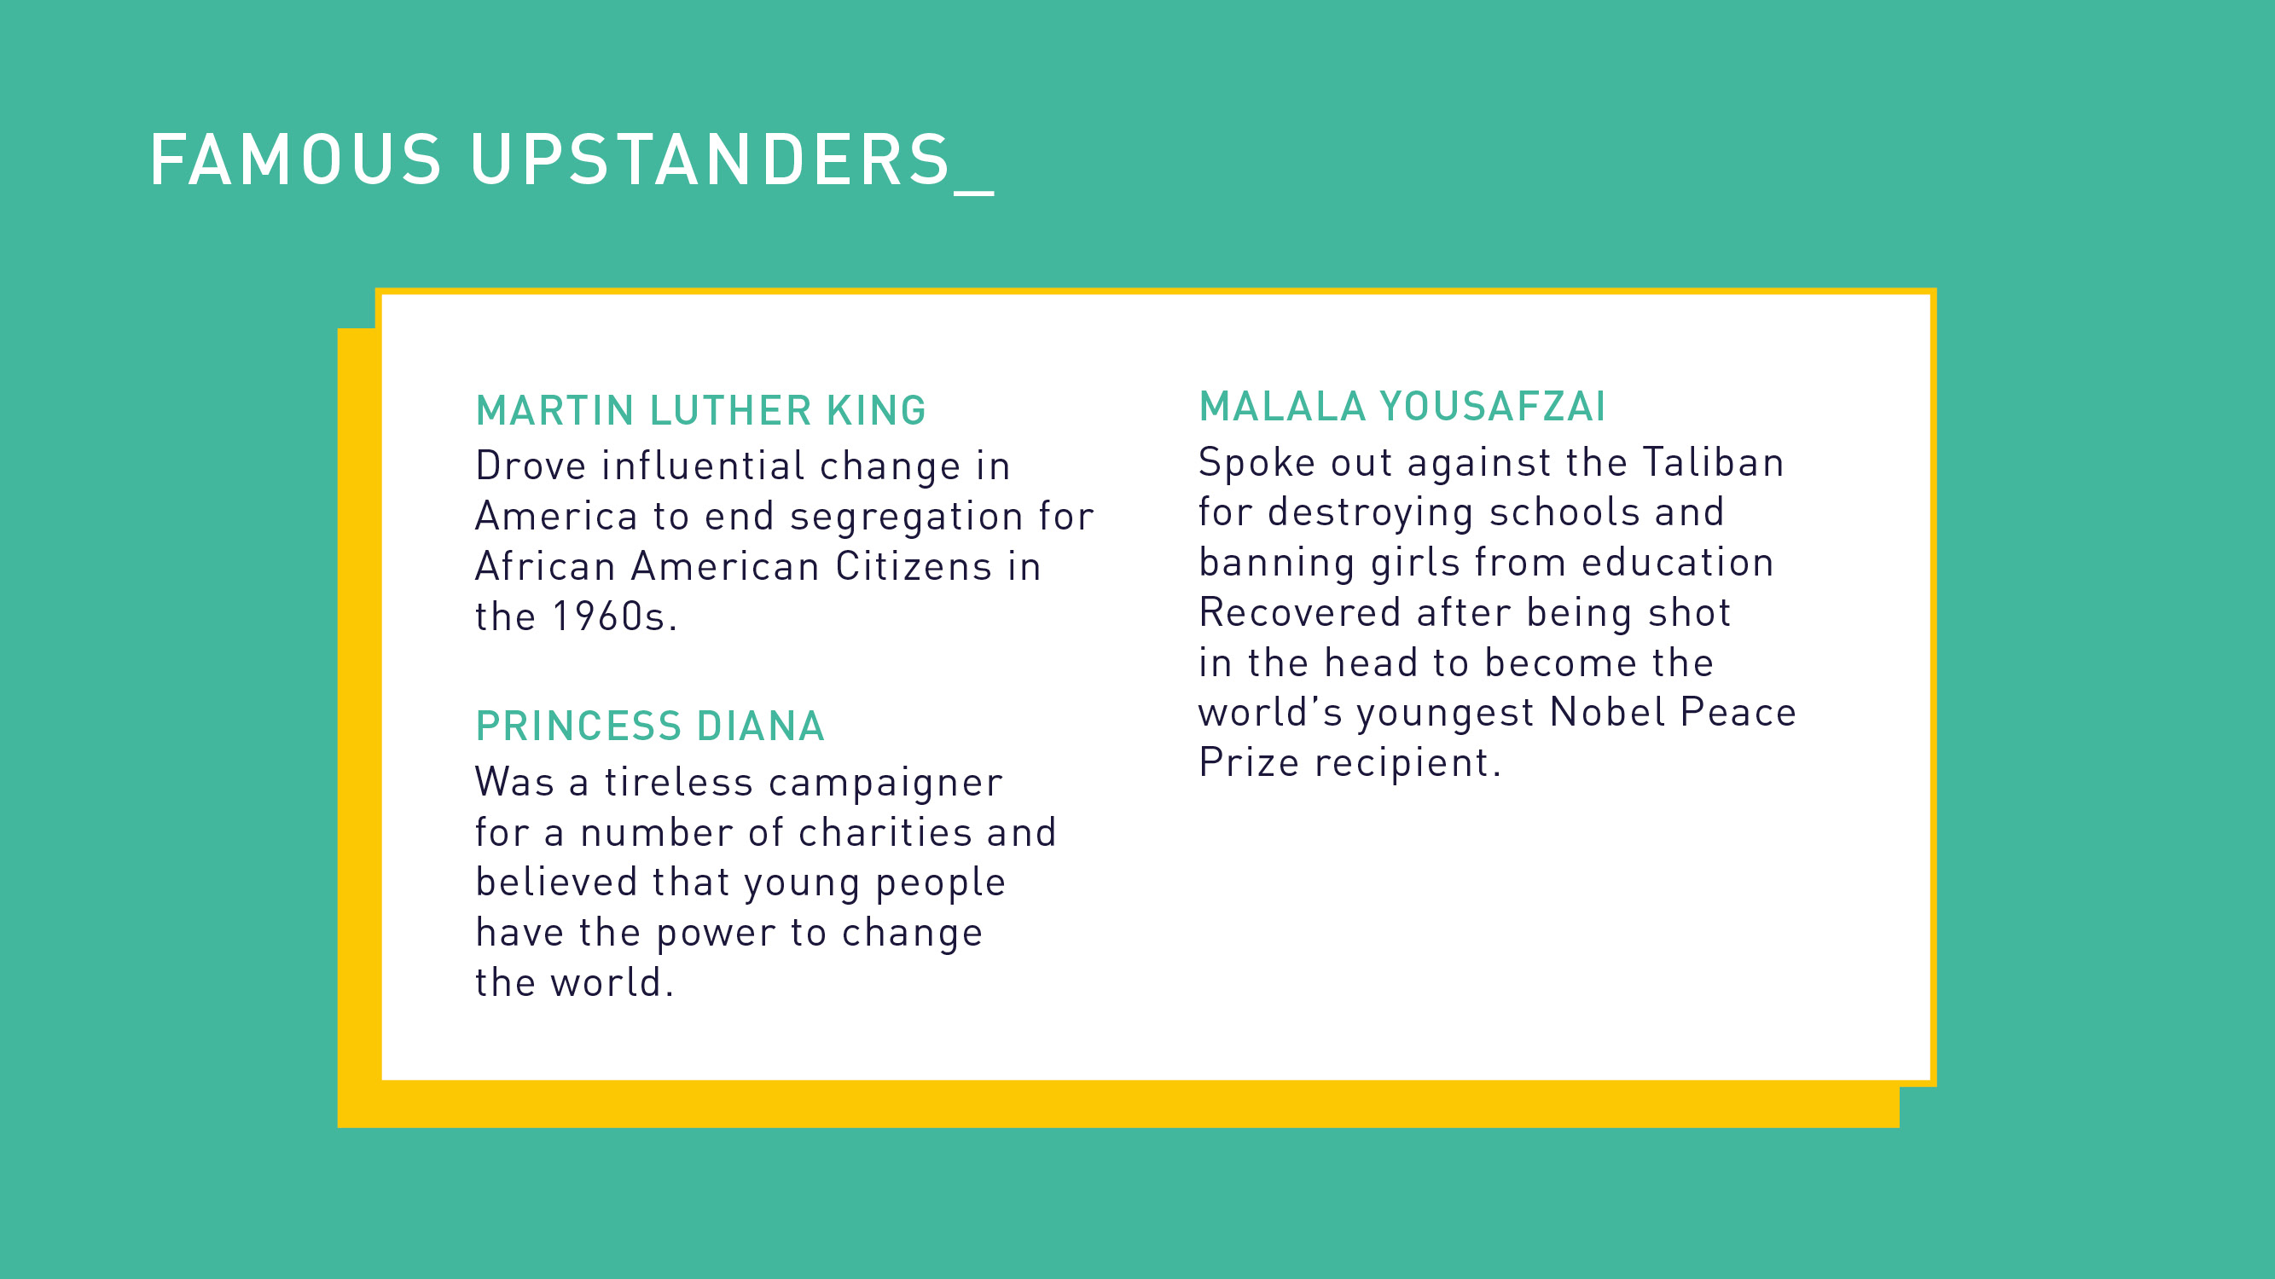

Slide 9
YOU!

Slide 10

Your mission today is to complete the upstander pledge challenge remember this is a PROMISE . . .

Slide 11

What will be your one kind word today?

Slide 12
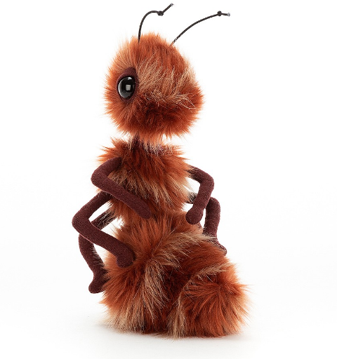
WOW
Wednesday
Today’s mission is sponsored by:
Aspirational Ant
Impress your teacher or T.A with your amazing learning and trying even harder to get better, or maybe celebrate someone who has achieved a certificate.
Celebrating a happy person can still brighten their day even if they’re very happy, it doesn’t hurt to gift the gifted.
Your mission today is to look at the banter v bullying resource

Slide 13


Slide 14


Slide 15
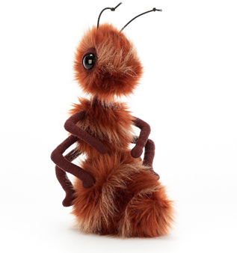
What will be your one kind word today?

Slide 16
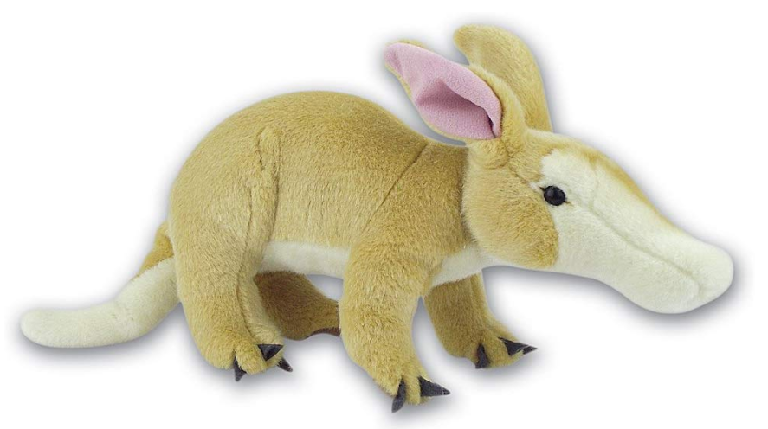
Thinking Thursday
Today’s mission is sponsored by:
Adventurous Aardvark
Try to persevere with getting used to something new, master different methods, different handwriting skills lots of new things.
Your mission today is to make an anti bullying pledge for everyone in your class to agree to.
Make it bold and visible this is your promise to each other

Slide 17
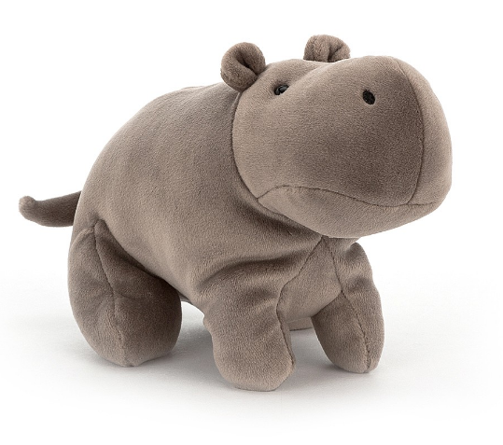
Friendlier Friday
Try and pay a unhappy classmate or anyone a nice compliment
Friendly Friday that is SUPER CHARGED!
Today’s mission is sponsored by:
Happy Hippo
https://www.bbc.co.uk/teach/school-radio/assemblies-ks2-diversity-difference-prejudice/z3f6qfr
Compliment someone from your class, write them a compliment slip to let them know why you appreciate them.

Slide 18

What will be your one kind word today?

Slide 19
What have you learned this week?
Which value animals were missing?
Why do you think they were missing?

Slide 20
Remember, you have the power to change the world!

