Slide 1
Let’s play a game of Guess Who!
Read the clues about one of your adults at school and see if you can work out who it is.

Slide 2
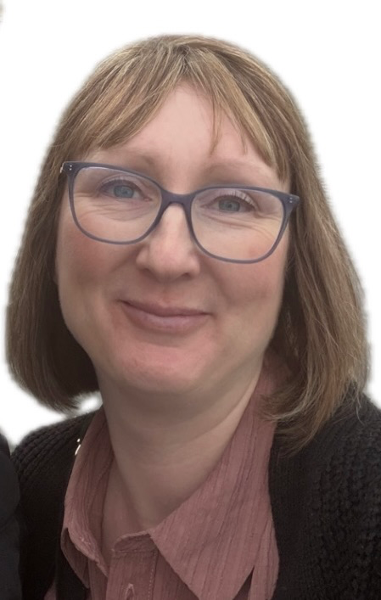
I wear glasses.
I have blonde, short hair.
I have 7 cats, 2 dogs and rabbit.
I love looking after the flowers in my garden.
I also love a coffee and cake.
Who am I?
It is Mrs Watson. I teach Bowie Class.

Slide 3
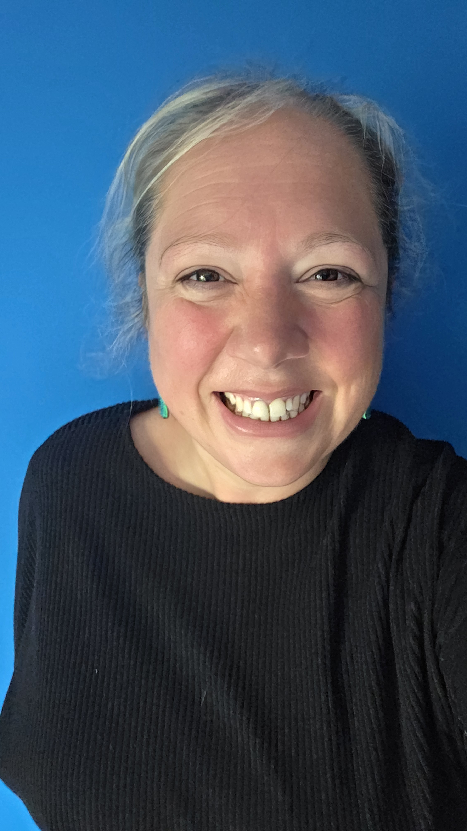
I like to wear big, colourful earrings.
I like glitter and sequins and even have some glittery school shoes!
I have two little girls at home who are 5 and 8.
I love reading and playing sport.
Who am I?
It is Mrs Copping. I teach Milhazes Class.

Slide 4
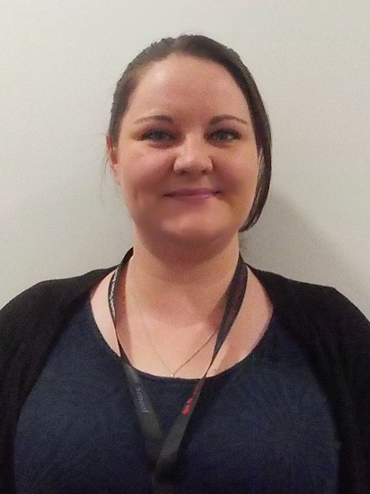
I wear glasses .
I have long, dark hair.
I do breakfast club in the mornings.
I have 2 cats and they are both very cheeky.
I love baking, making things and gardening.
Who am I?
It is Miss Reeves.

Slide 5
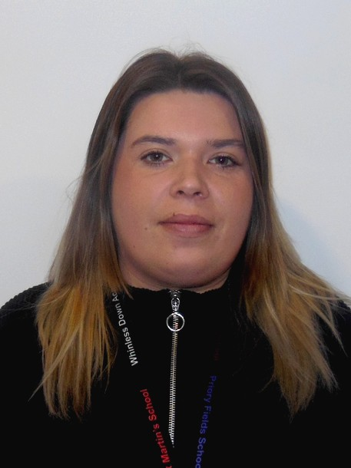
I have long hair .
I have 2 children.
I do breakfast club in the mornings.
I have 1 dog and she loves a long walk.
I love making things and wearing leopard print!
Who am I?
It is Miss Carter.

Slide 6
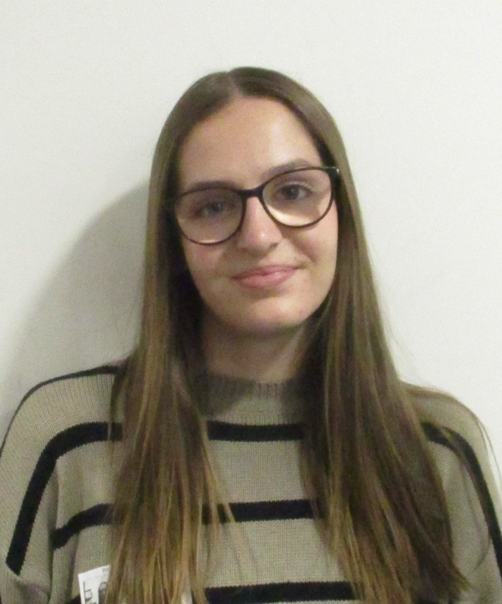
I have long hair .
I wear glasses.
I like colouring, playing in the garden and doing ‘Bucket Time’.
I like dogs.
I love anything strawberry.
Who am I?
It is Miss Robertson.

Slide 7
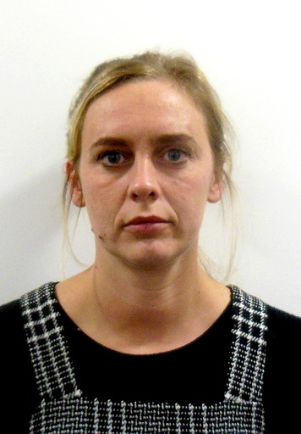
I have long blonde hair .
I have 2 children.
I like spending time in the garden.
I like going on holiday with my family.
I love drinking coffee.
Who am I?
It is Miss Marshall.

Slide 8
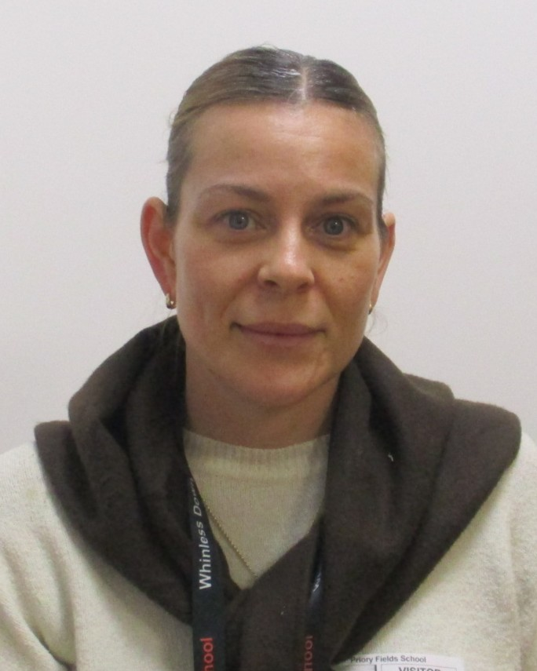
I have long brown hair .
I have 2 children who are 5 and 8.
I love reading and Forest School.
I like to spend time outside.
I love to play netball.
Who am I?
It is Miss Martin.

Slide 9
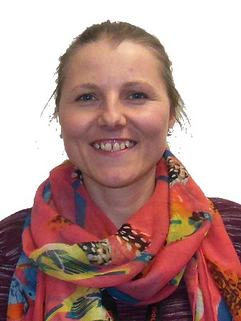
I have short brown hair .
I am normally in the office but I always like to pop in and see you!
I love talk to you and your parents
in the morning when I see you on the gate.
I like baking, walking and swimming in the sea.
I love my dog!
Who am I?
It is Mrs Hayes

Slide 10
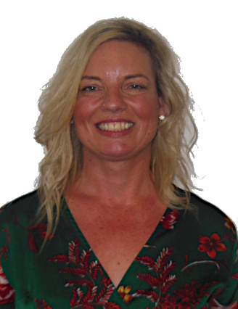
I have long blonde hair .
I am normally in the office but I always like to pop in and see you!
I love talking to you and your parents in the morning and after school.
I like being a Nanny.
I love spending time having fun with my family and friends.
Who am I?
It is Mrs Howarth

Slide 11
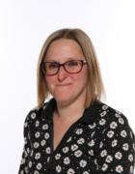
I have short brown hair and wear glasses.
I work in all the different schools but I always like to pop in and see you!
I love playing and learning with you in the garden and in the classrooms.
I like to go to the beach.
I love seeing all your smiley faces enjoying your learning.
Who am I?
It is Mrs Bishop

